Slide 1
Sentimental Analysis web App

Slide 2
Problem Statement
Understanding and analyzing the sentiment behind user-generated text is crucial for businesses, social media monitoring, and customer feedback.
Traditional manual sentiment analysis is time-consuming and inconsistent.
Automating sentiment detection helps in real-time insights for better decision-making.
Importance:
Enhancing Decision-Making: Businesses and organizations rely on sentiment analysis to understand customer opinions, helping them improve products and services.
Real-World Context & Motivation:
Customer Feedback Analysis: Companies like Amazon and Google use sentiment analysis to analyze product reviews and improve user experience.
Social Media Monitoring: Governments, brands, and influencers track public sentiment on platforms like Twitter to gauge opinions and trends in real time.

Slide 3
Objectives:
Develop a web-based sentiment analysis tool to classify text as positive, negative, or neutral.
Implement a machine learning model trained on a dataset of tweets for accurate classification.
Provide an interactive user interface for real-time sentiment analysis.
Improve accuracy by cleaning and preprocessing text data.

Slide 4
Methodology
Frontend Development: Designed a simple web interface using HTML, CSS, and JavaScript.
Basic Sentiment Analysis in JavaScript: Used keyword matching to classify text as positive, negative, or neutral.
Machine Learning Model: Trained a Naïve Bayes classifier using Python and Tweets dataset for better sentiment prediction.
Text Preprocessing: Cleaned data by removing stop words, punctuation, and applying lemmatization.
Model Deployment: Integrated the trained ML model with the web app for real-time sentiment analysis.
Tools & Technologies
Frontend: HTML, CSS, JavaScript
Backend & Machine Learning: Python, Pandas, NLTK, Scikit-Learn
Dataset: Airline tweets dataset (Tweets.csv)
ML Algorithm: Naïve Bayes Classifier
Libraries: NLTK, Scikit-learn, CountVectorizer, WordNetLemmatizer
ML Model: Naïve Bayes Classifier

Slide 5
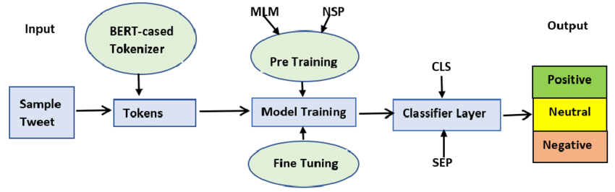
System Architecture/Design:
The diagram presents a sentiment analysis pipeline using BERT. Key components include:
Tokenizer: Prepares input text by tokenizing it into recognizable segments.
Pre-training: Uses tasks like Masked Language Model (MLM) and Next Sentence Prediction (NSP) to train the model.
Fine-tuning & Classification: Adapts the model to specific sentiment analysis tasks, classifying text as Positive, Neutral, or Negative.

Slide 6
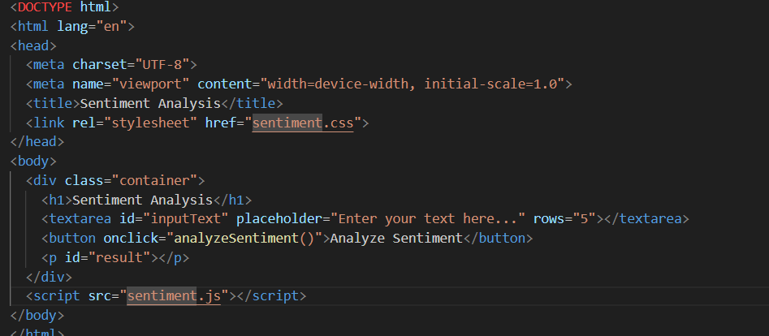
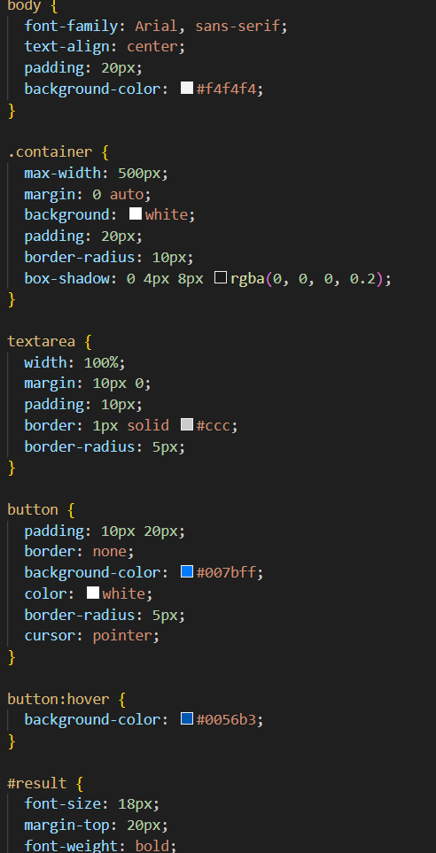
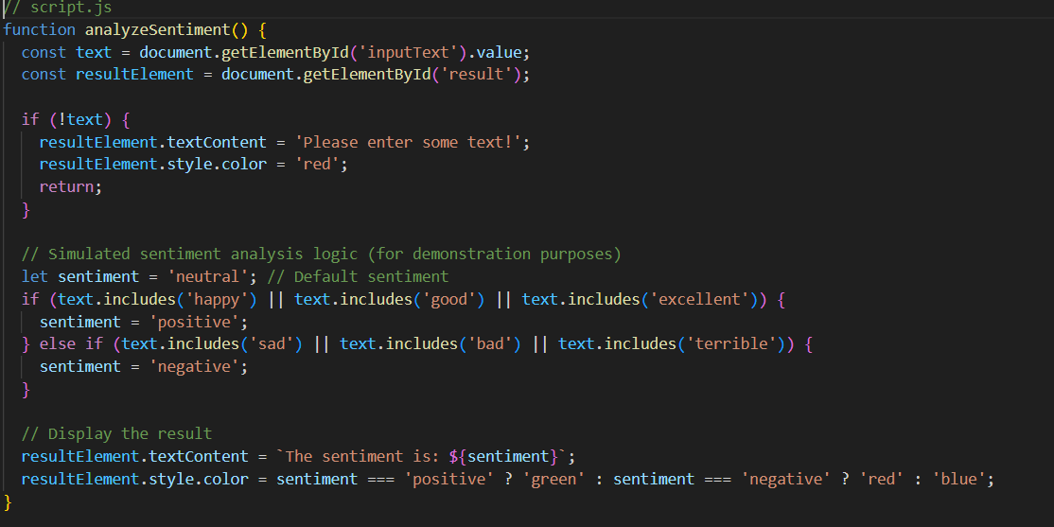
Front End:

Slide 7
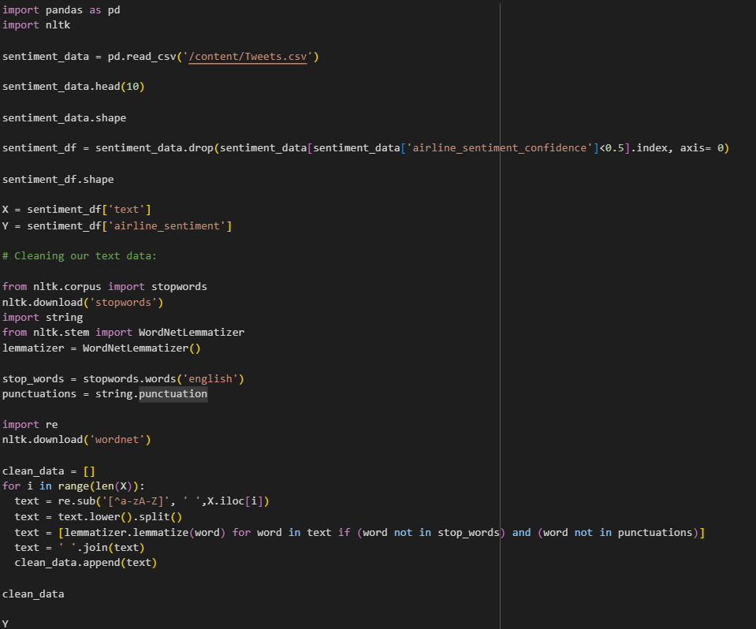
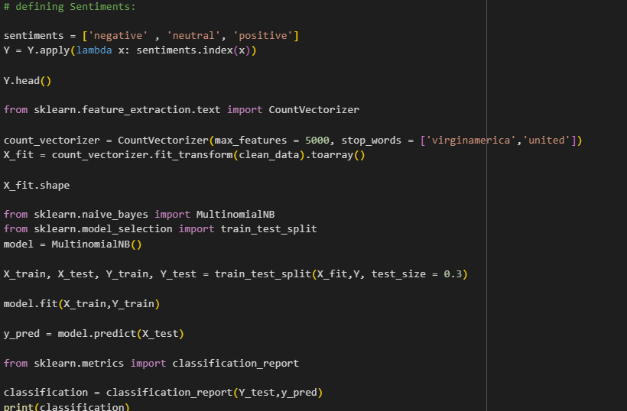
Implementation/Development:

Slide 8
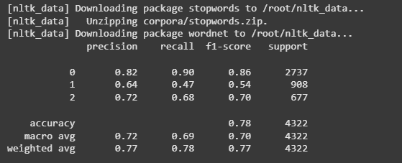
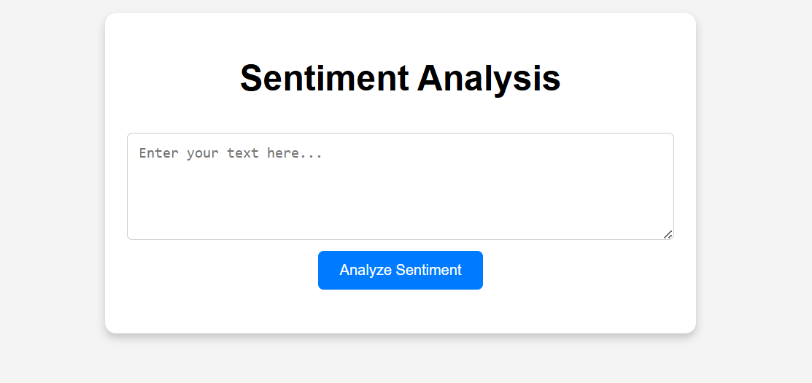
Outputs:

Slide 9
Results/Output:
Applications of Sentiment Analysis: Sentiment analysis is useful for understanding customer satisfaction, market trends, and public reactions during events or crises. Industries use it for improving products, gauging public opinion, or enhancing services. It's applied across domains like healthcare, politics, and social media monitoring.
Target Users and Industries: E-commerce, marketing, and media industries benefit from sentiment analysis to enhance campaigns and content. Finance sectors use sentiment data for market predictions, while public sectors leverage it for policy-making. Its application spans industries aiming to better understand their audiences.
Future Scalability Ideas: Real-time sentiment tracking can revolutionize event monitoring and decision-making. Integrating text, audio, and video enriches insights, while ethical AI improves fairness. Domain adaptation and IoT integration broaden its scope and personalize user experiences.
If you'd like more expansion on these, I'm here to help!

Slide 10
Conclusion:
Summary of Key Results: Sentiment analysis using techniques like BERT effectively classifies text into Positive, Neutral, or Negative categories. It provides actionable insights for businesses, politics, and healthcare by analyzing customer feedback, public opinion, and social media trends. Real-world applications demonstrate its ability to enhance decision-making and user experience.
What’s Next? (Improvements & Extensions):
Improve real-time tracking for live sentiment analysis.
Develop multimodal analysis by combining text, audio, and video inputs.
Customize models for specific domains and languages to widen applicability.
Enhance ethical AI practices to reduce biases in sentiment predictions.
Explore IoT integration to create context-aware, sentiment-driven smart devices.
Lessons Learned:
Sentiment analysis is powerful, but accuracy depends on quality and diversity of training data.
Addressing biases is crucial for fair and reliable insights.
Scalability demands constant adaptation to new platforms, languages, and inputs.
Domain-specific knowledge significantly improves precision.
Ethical considerations, like data privacy, are vital for long-term trust and success.
Would you like further help in exploring any of these areas in depth?

Slide 11
Thank You
Feeling gratitude and not expressing it is like wrapping a present and not giving it.

